Slide 1
Scheme for constructing clone trees
Cluster mutations
Build trees starting from crude structure based on sample presence/absence

Slide 2
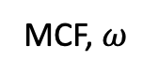
Simulated data: 100 variants total, 10 per cluster
MCF, $ω$
Root
k | S1 | S2 | S3
1 | 0.98 | 0.99 | 0.97
2 | 0.98 | 0.90 | 0.82
3 | 0.55 | 0.00 | 0.80
4 | 0.20 | 0.00 | 0.50
5 | 0.30 | 0.00 | 0.30
6 | 0.43 | 0.90 | 0.00
7 | 0.30 | 0.70 | 0.00
8 | 0.20 | 0.00 | 0.00
9 | 0.00 | 0.00 | 0.30
10 | 0.00 | 0.50 | 0.00
S1, S2, S3
1
2
S1, S3
S1, S2
3
6
4
5
7
S1
S3
S2
8
9
10

Slide 3
Clustering first – z results
S1, S2, S3
1
2
S1, S3
S1, S2
3
6
4
5
7
S1
S2
S3
8
9
10
Simulated data: 100 variants total, 10 per cluster

Slide 4
Crude tree structure based on sample presence
Root
Level 3:
Present in 3 samples
S1, S2, S3
Level 2:
Present in 2 samples
S1, S2
S1, S3
S2, S3
Level 1:
Present in 1 sample
S1
S2
S1
S3
S2
S3

Slide 5
Crude tree structure based on sample presence
Root
ω
Level 3:
Present in 3 samples
S1, S2, S3
Level 2:
Present in 2 samples
S1, S2
S1, S3
S2, S3
Level 1:
Present in 1 sample
S1
S2
S1
S3
S2
S3
Present in sample if ω > 0.01

Slide 6
Crude tree structure based on sample presence
Root
ω
Level 3:
Present in 3 samples
S1, S2, S3
Level 2:
Present in 2 samples
S1, S2
S1, S3
S2, S3
Level 1:
Present in 1 sample
S1
S2
S1
S3
S2
S3
Present in sample if ω > 0.01

Slide 7
Adjacency matrix – construct base with restraints
To
ω
 | 1 | 2 | 3 | 4 | 5 | 6 | 7 | 8 | 9 | 10
Root
1
2
3 | - | - |  |  |  | - | - |  |  | -
4 | - | - |  |  |  | - | - |  |  | -
5 | - | - |  |  |  | - | - |  |  | -
6 | - | - | - | - | - |  |  |  | -
7 | - | - | - | - | - |  |  |  | -
8 | - | - | - | - | - | - | - |  | - | -
9 | - | - | - | - | - | - | - | - |  | -
10 | - | - | - | - | - | - | - | - | -
Present in sample if ω > 0.01
From
Restraints:
Can’t go to self
No restraints if present in same set of samples
Restraint if # of from.samples < # of to.samples
Restraint if to.samples is not subset of from.samples

Slide 8
Adjacency matrix – construct base with restraints
To
 | 1 | 2 | 3 | 4 | 5 | 6 | 7 | 8 | 9 | 10
Root
1
2
3 | - | - |  |  |  | - | - |  |  | -
4 | - | - |  |  |  | - | - |  |  | -
5 | - | - |  |  |  | - | - |  |  | -
6 | - | - | - | - | - |  |  |  | -
7 | - | - | - | - | - |  |  |  | -
8 | - | - | - | - | - | - | - |  | - | -
9 | - | - | - | - | - | - | - | - |  | -
10 | - | - | - | - | - | - | - | - | -
From

Slide 9
Adjacency matrix – initialize random values
Randomly assign 1 to a possible position in each column
First row (root) must have at least one 1

Slide 10
Adjacency matrix – mutate
Randomly pick a column to mutate
Select new possible position to be 1

Slide 11
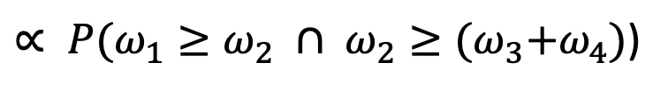

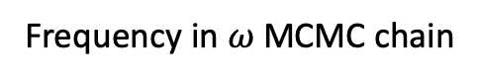
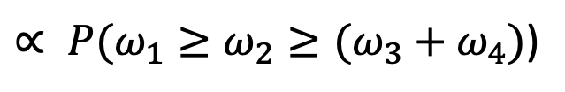
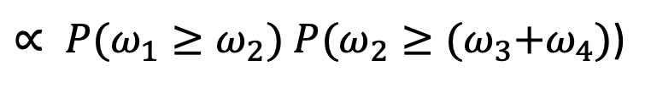
Tree scoring
$$P\left(Tree | ω_{1},…,ω_{k}\right)∝P\left(ω_{1},…,ω_{k} | Tree\right) P(Tree)$$
N
$∝ P(ω_{1}≥ω_{2}≥(ω_{3}+ω_{4})$)
$∝ P(ω_{1}≥ω_{2} ∩ ω_{2}≥{(ω}_{3}+ω_{4})$)
1
$∝ P(ω_{1}≥ω_{2}) P(ω_{2}≥{(ω}_{3}+ω_{4})$)
2
3
4
Frequency in $ω$ MCMC chain

Slide 12
Scoring function is not great…
Top scoring adjacency matrix (p=0.156)
*true adjacency matrix p=0.04

Slide 13
Tree scoring in SCHISM
$$i$$
$$j$$
$$k$$
$$Z\left(T\right)=TC\left(T\right)+MC(T)$$
Tree
fitness
Topology
cost
Mass
cost
Lineage precedence
rule: $C_{i}≥C_{j}$, $C_{i}≥C_{k}$
Violations of lineage precedence
Violations of lineage divergence
Lineage divergence
rule: $C_{i} ≥ C_{j}+ C_{k}$

Slide 14
Topology Cost is the sum of lineage precedence violations across all ancestor-descendant pairs in a tree
Violations of lineage precedence are determined by a GLRT
$$H0 : i →j$$
:
$$(C_{i}≥C_{j})$$
Ding et al, Nature (2012) – acute myeloid leukemia

Slide 15
Mass Cost is the total magnitude of violations of the lineage divergence rule
$${mc}^{s}\left(n\right)=\left\{ \begin{aligned}0, C_{ p(n)}^{s}≥\sum_{q∈D(n)}{C_{q}^{s}} \\ &{\left(\sum_{q∈D\left(n\right)}{C_{q}^{s}}\right)− C}_{p\left(n\right)}^{s}, { C}_{p(n)}^{s}<\sum_{q∈D(n)}{C_{q}^{s}}\end{aligned}\right.$$
Node mass cost in a specific sample S
$$mc\left(n\right)= \sqrt{\sum_{s=1}^{S}{{\left({mc}^{s}(n)\right)}^{2}}}$$
Node mass cost
$$MC\left(T\right)= \sum_{n ∈N(T)}{mc(n)}$$
Tree mass cost
Slide courtesy of Noushin Niknafs

Slide 16
Score chain using SCHISM scoring function
How to better explore tree space?

Slide 17
True tree
True adjacency matrix (fitness=0.64)
True ω
8
7
10
4
9
6
3
5
Highest scoring adjacency matrix (fitness=0.86)
Mean ω from MCMC

Slide 18
True adjacency matrix (fitness=0.64 using mean ω )
True ω
True tree
Root
S1, S2, S3
1
2
S1, S3
S1, S2
8
7
10
4
9
Highest scoring adjacency matrix (fitness=0.86)
Mean ω from MCMC
S1
S3
S2
6
3
5

Slide 19
Adjacency matrix
To
 | 1 | 2 | 3 | 4 | 5 | 6 | 7 | 8 | 9 | 10
Root | 1
1 |  | 1
2 |  |  |  |  |  |  | 1 | 1
3 | - | - | - | - | - | - | - | - | - | -
4 | - | - | 1 |  | - |  | - |  | -
5 | - | - | - | - | - | - | - | - | - | -
6 | - | - | - | - | - |  | - | - | - | -
7 | - | - | - | - |  |  |  | - | 1 | -
8 | - | - |  | 1 | - |  | - |  | - | 1
9 | - | - | - | - | 1 |  |  | - |  | -
10 | - | - |  |  | - | 1 | - |  | -
1
2
8
7
10
4
9
From
6
3
5

